Slide 1
Common Core
Heart-Based Language and Literacy

Slide 2
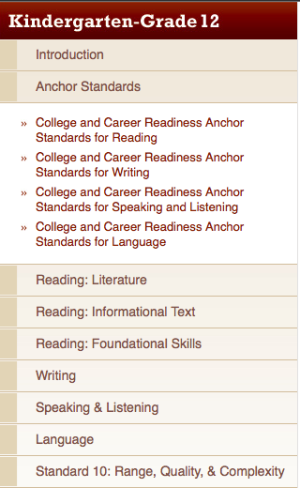
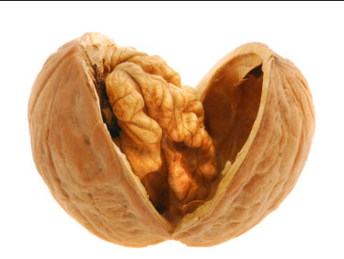

10 + 10 + 6 + 6 = 32
College Readiness

Slide 3
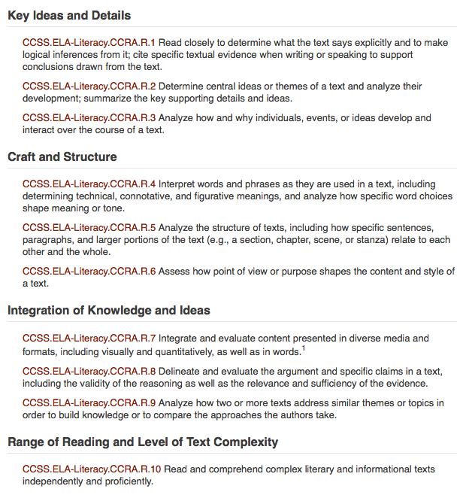

10 Anchor Standards for Reading
1, 4, 9, 10

Slide 4
English Language Arts Standards » College and Career Readiness Anchor Standards for Reading » 1
Read closely to determine what the text says explicitly and to make logical inferences from it; cite specific textual evidence when writing or speaking to support conclusions drawn from the text.

Slide 5
English Language Arts Standards » College and Career Readiness Anchor Standards for Reading » 4
Interpret words and phrases as they are used in a text, including determining technical, connotative, and figurative meanings, and analyze how specific word choices shape meaning or tone.

Slide 6
English Language Arts Standards » College and Career Readiness Anchor Standards for Reading » 9
Analyze how two or more texts address similar themes or topics in order to build knowledge or to compare the approaches the authors take.

Slide 7
English Language Arts Standards » College and Career Readiness Anchor Standards for Reading » 10
Read and comprehend complex literary and informational texts independently and proficiently.

Slide 8
Critical Literacy
The ability to read texts in an active, reflective manner to better understand power, inequality, and injustice in human relationships.

Slide 9
Close Reading
Rereading for deep understanding

Slide 10
1 Reading for Jist
Annotating
What is happening?

Slide 11
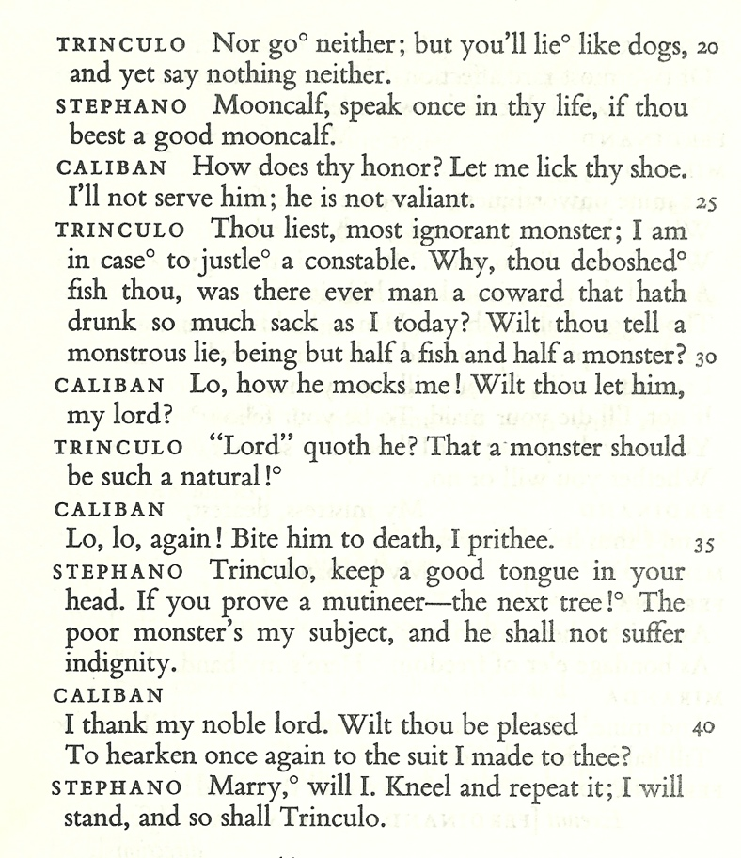
THE TEMPEST by William Shakespeare
CALIBAN: a savage and deformed slave
TRINCULO: a jester
STEPHANO: a drunken butler
TRINCULO Servant monster? The folly of this island! They say there’s five upon this isle; we are three of them. If th’ other two be brained like us, the state totters.

Slide 12
What is the jist?
Use specific examples from the text.

Slide 13
THE TEMPEST by William Shakespeare
CALIBAN: a savage and deformed slave
TRINCULO: a jester
STEPHANO: a drunken butler
TRINCULO Servant monster? The folly of this island! They say there’s five upon this isle; we are three of them. If th’ other two be brained like us, the state totters.

Slide 14
Reread
For Word Meaning and Double Meanings (Puns)

Slide 15
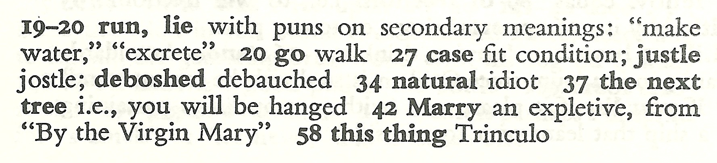
TRINCULO Servant monster? The folly of this island! They say there’s five upon this isle; we are three of them. If th’ other two be brained like us, the state totters.

Slide 16
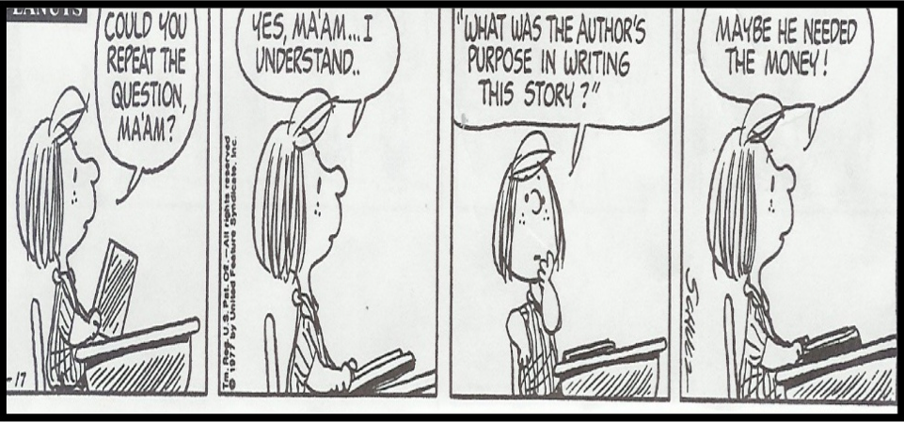

Slide 17
What is the author’s purpose?

Slide 18
Reread
For Character Analysis

Slide 19
The Tempest by William Shakespeare
CALIBAN: a savage and deformed slave
TRINCULO: a jester
STEPHANO: a drunken butler
TRINCULO Servant monster? The folly of this island! They say there’s five upon this isle; we are three of them. If th’ other two be brained like us, the state totters.

Slide 20
What do you know about the characters?

Slide 21
How did Shakespeare use class?
What is the hierarchy among these 3 characters?

Slide 22
English Language Arts Standards » College and Career Readiness Anchor Standards for Reading » 9
Analyze how two or more texts address similar themes or topics in order to build knowledge or to compare the approaches the authors take.

Slide 23


Slide 24

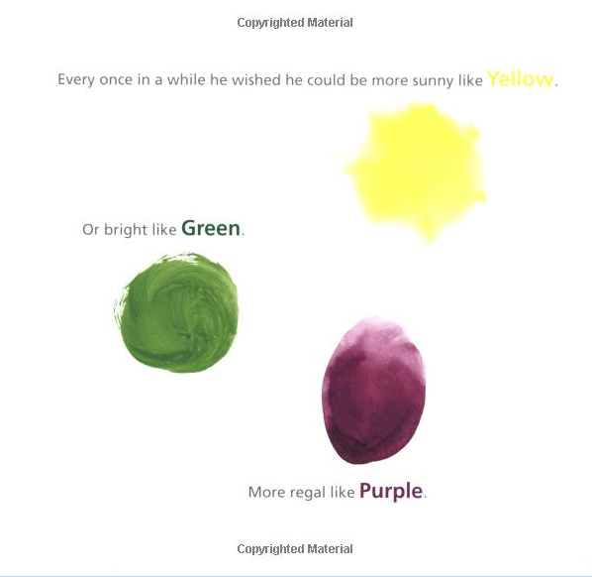
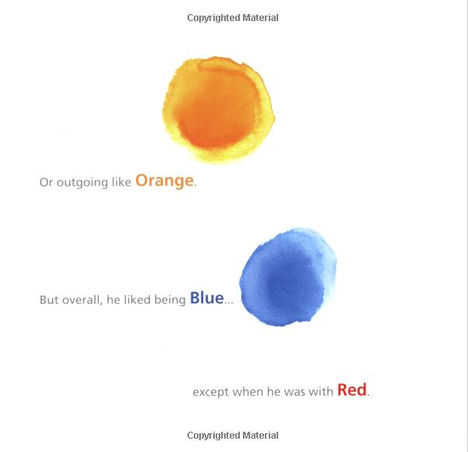
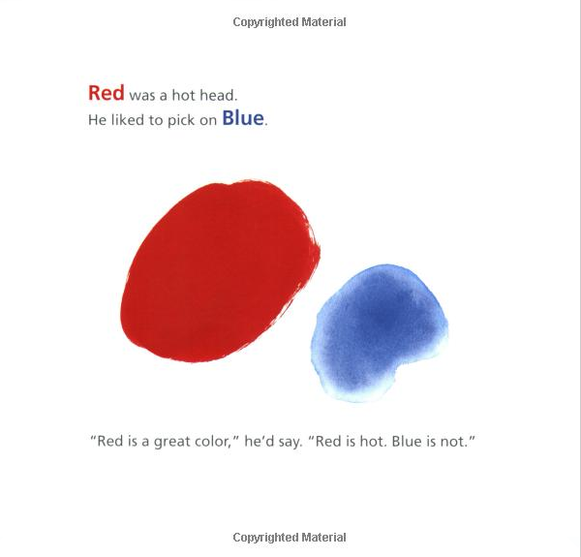

Slide 25


Slide 26
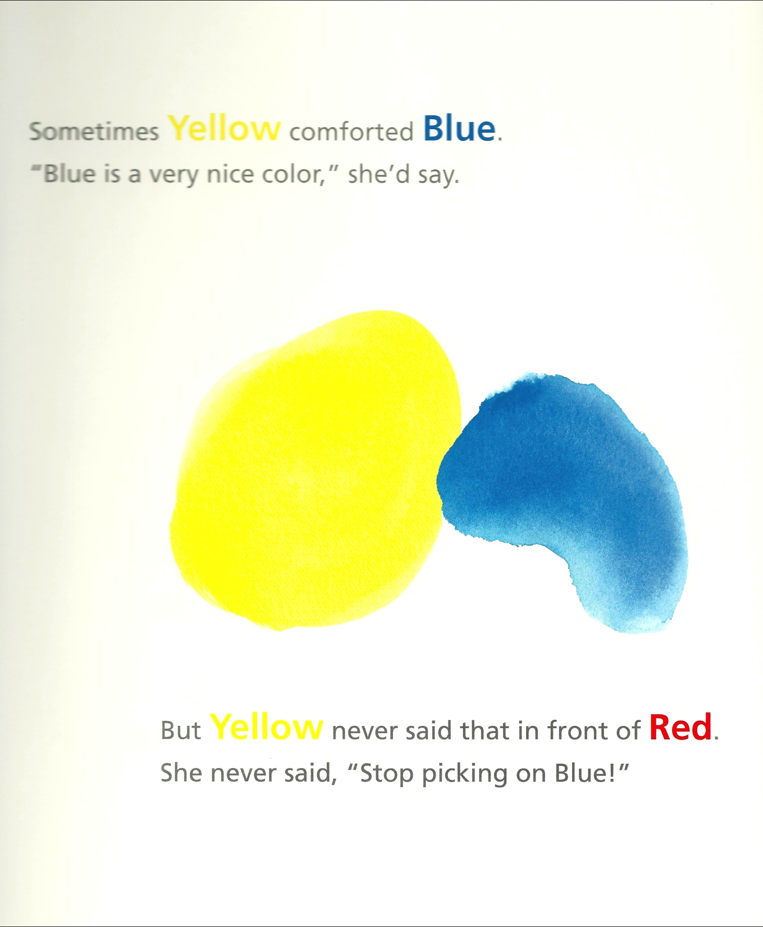

Slide 27
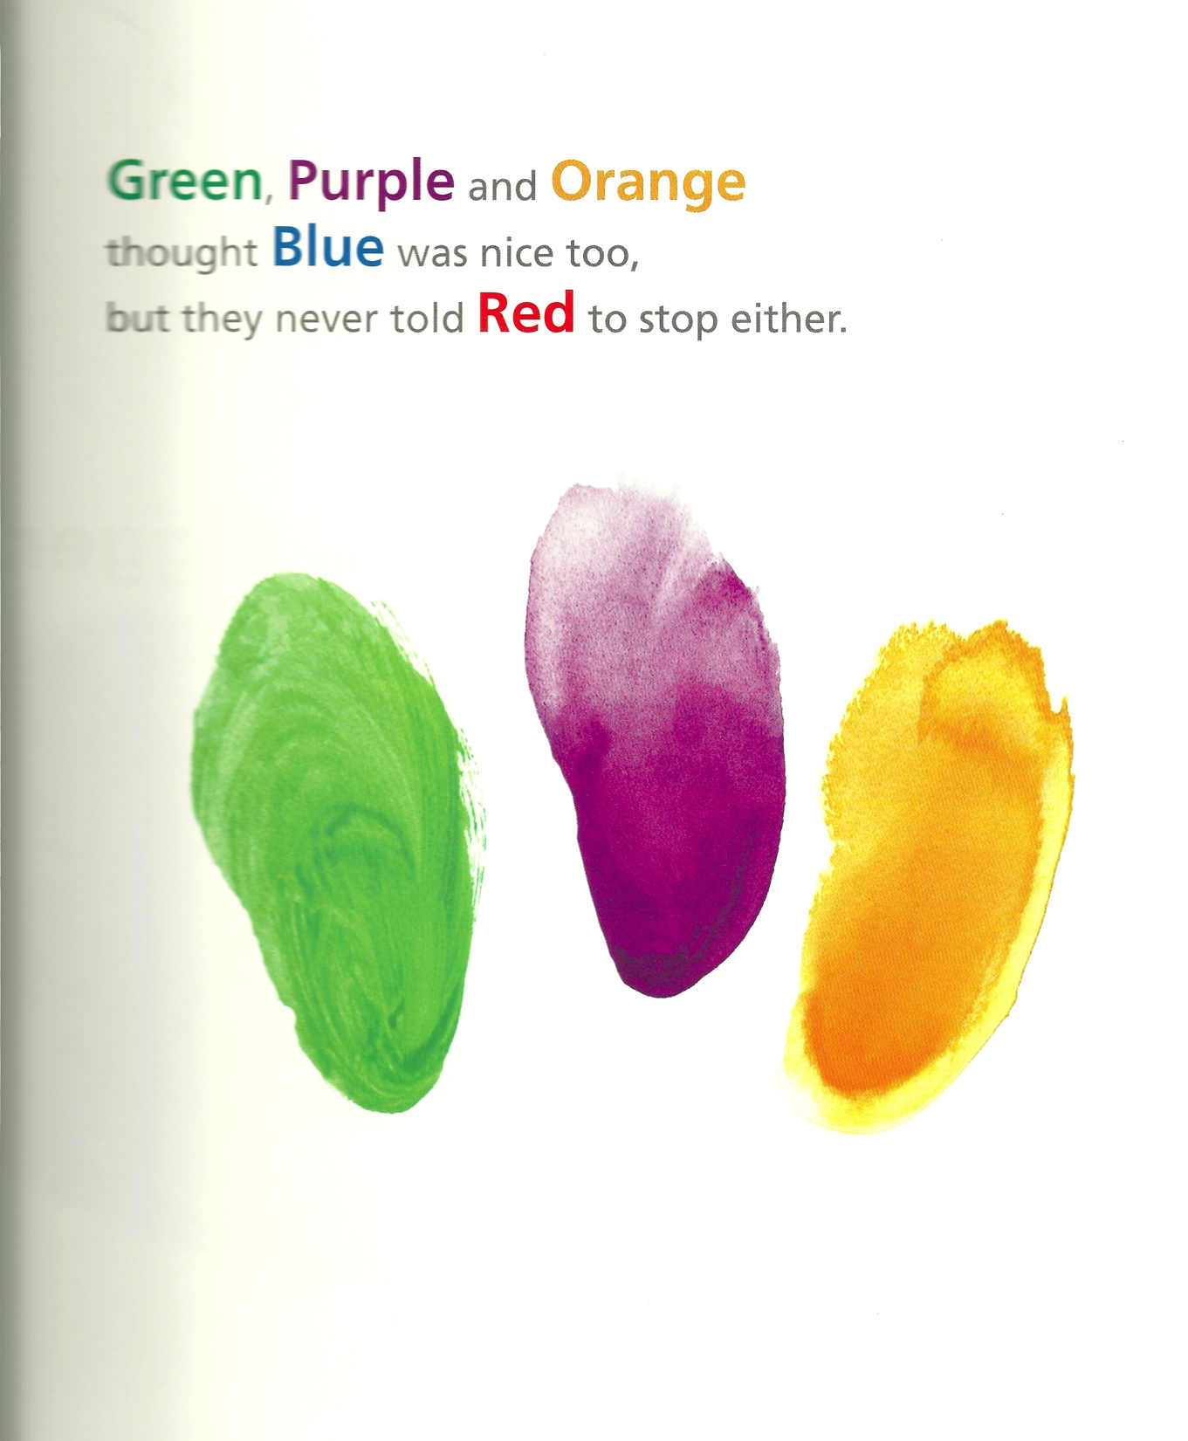

Slide 28
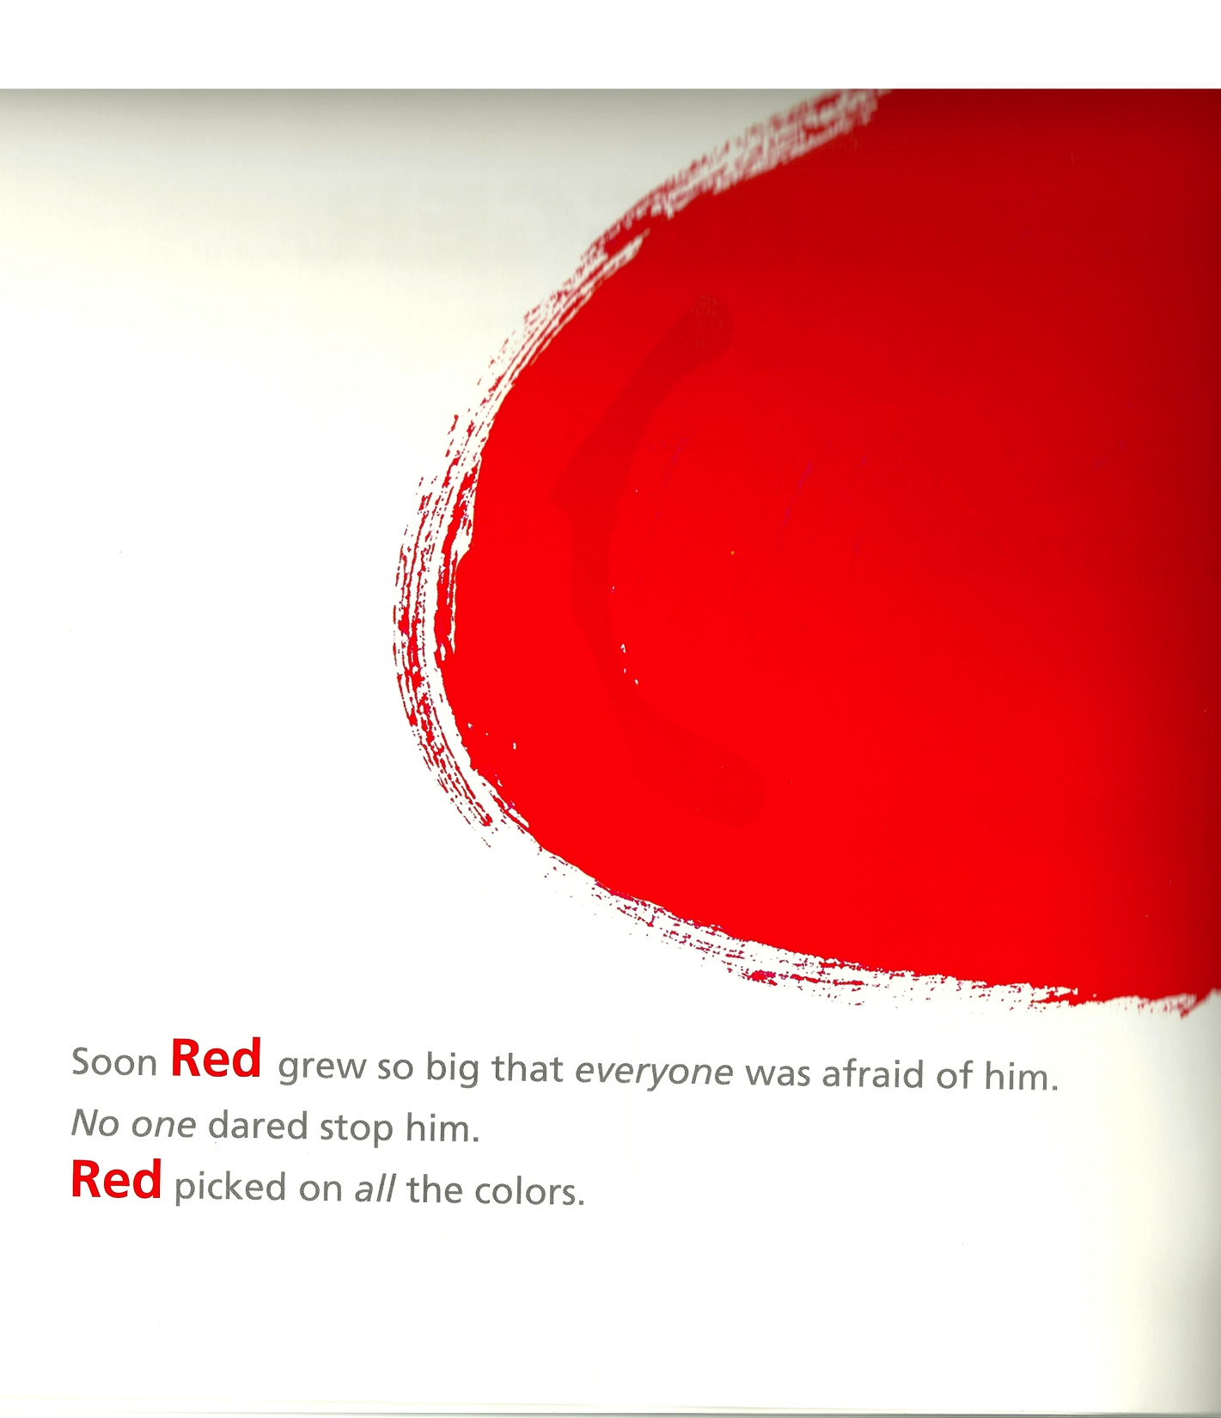


Slide 29
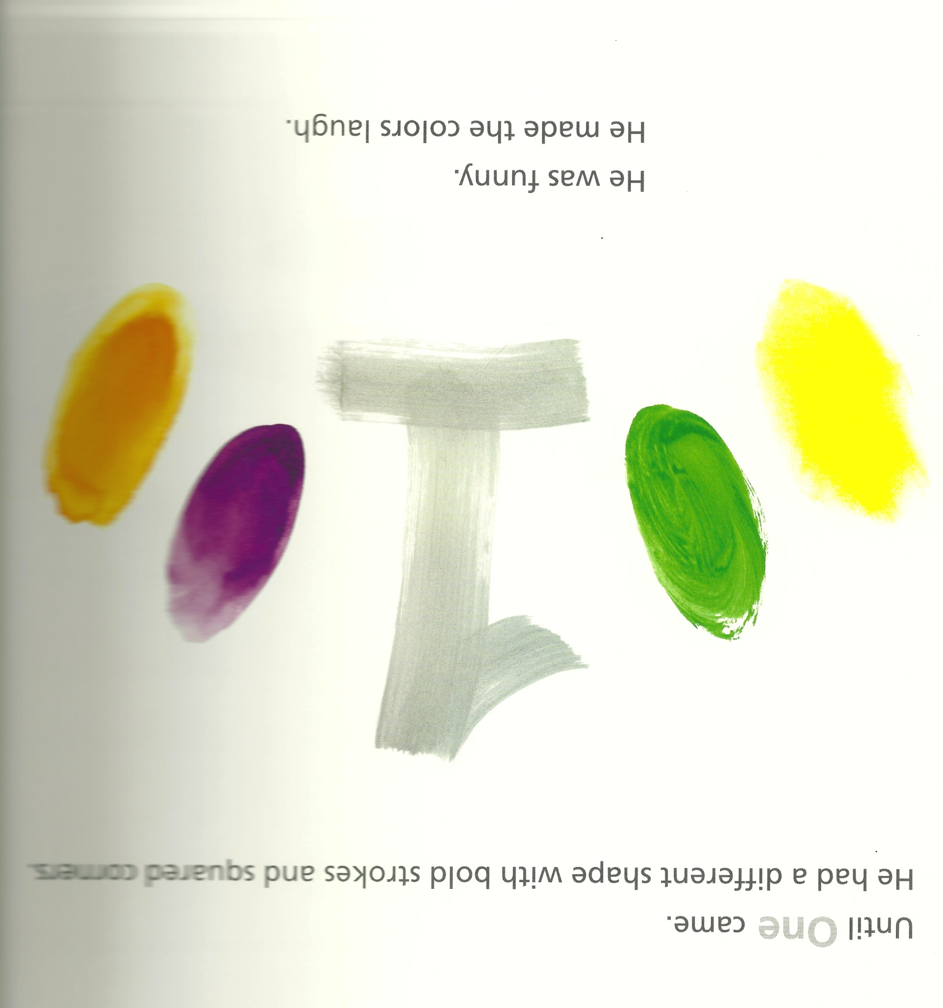

Slide 30
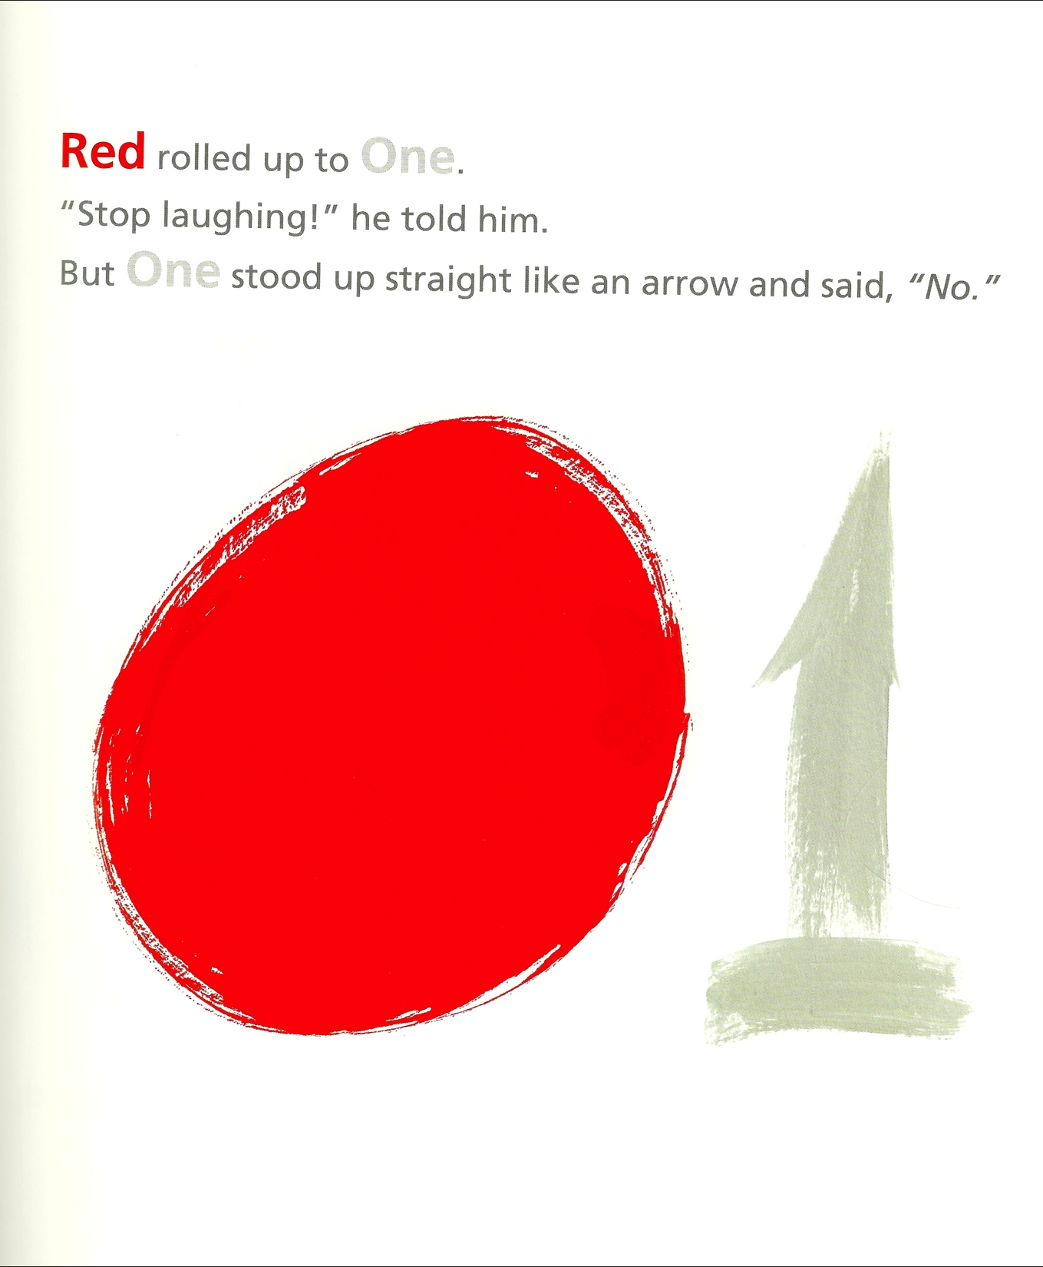

Slide 31
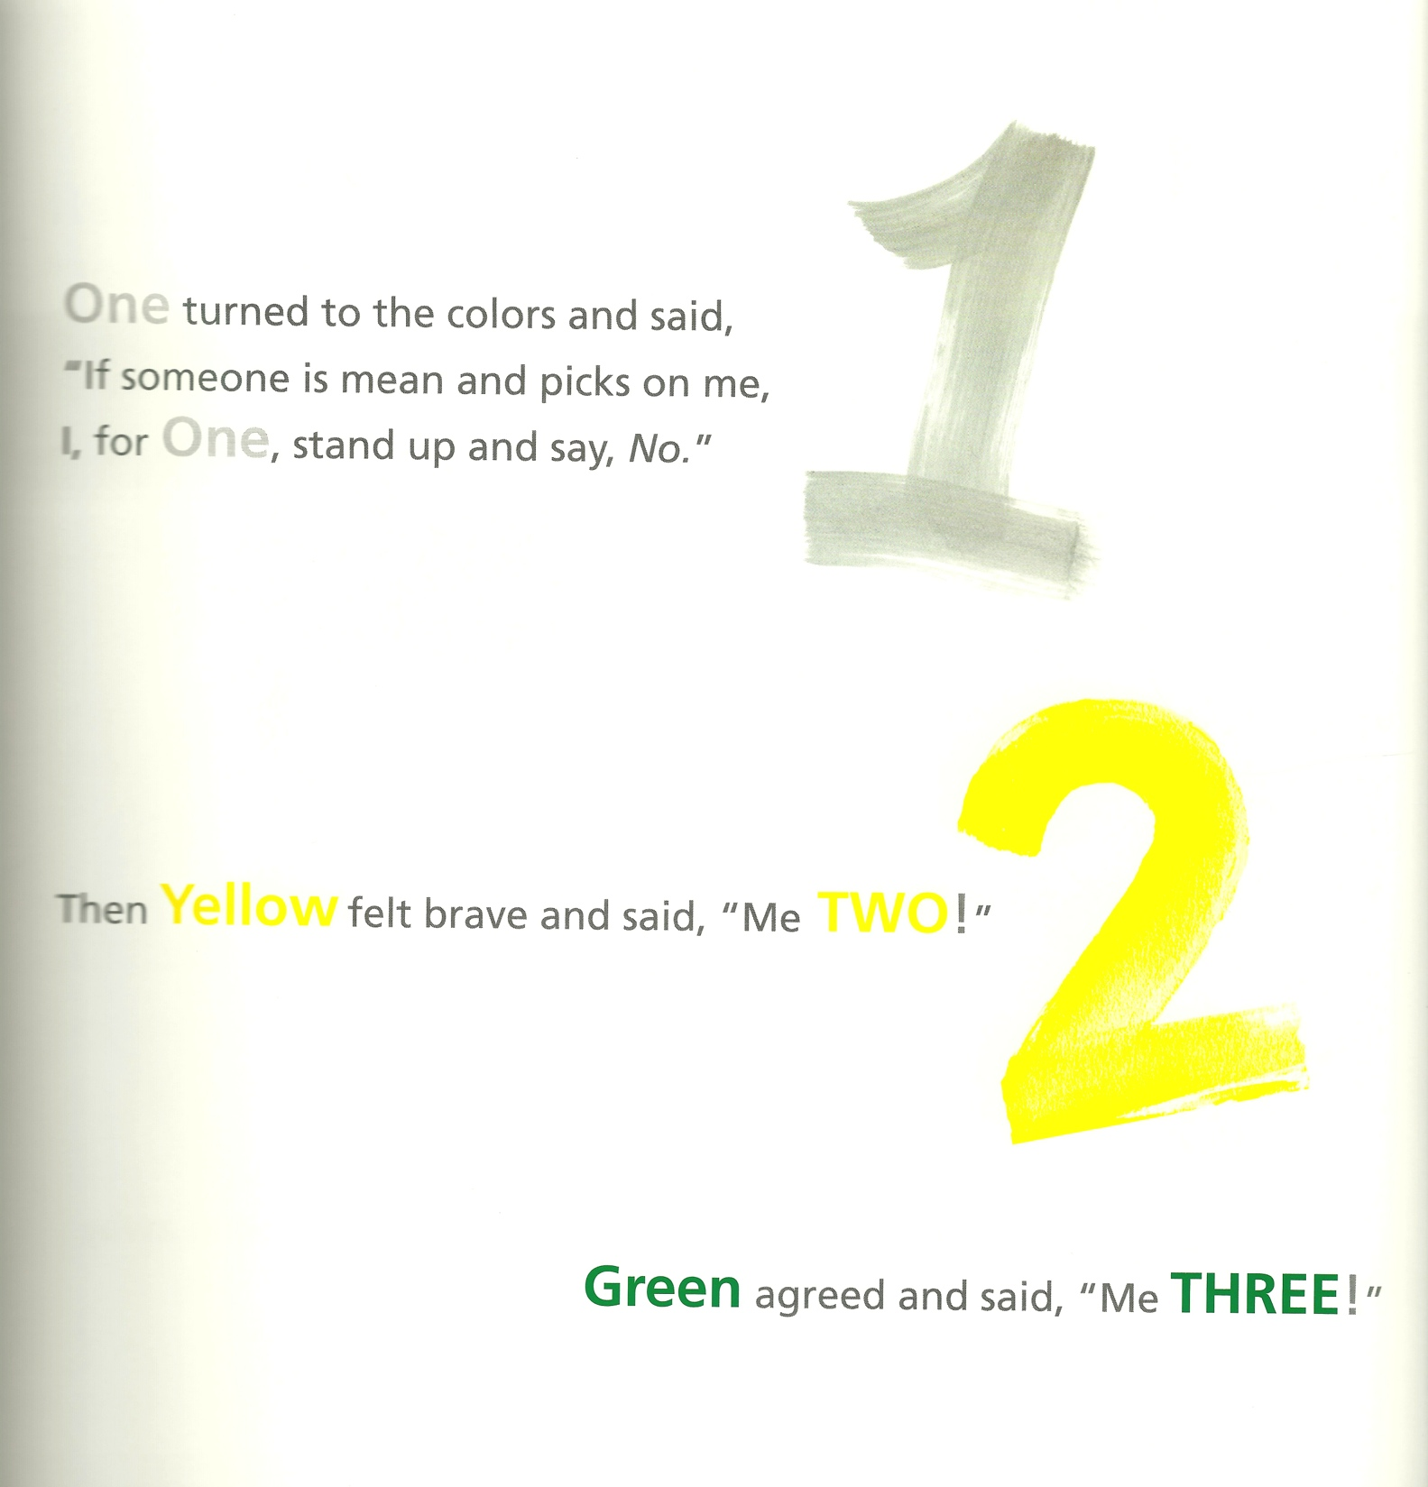

Slide 32
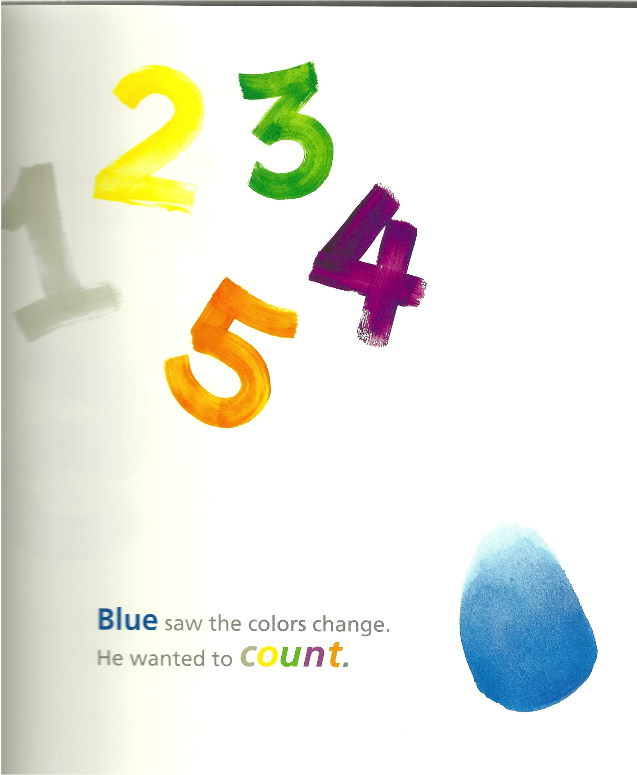

Slide 33
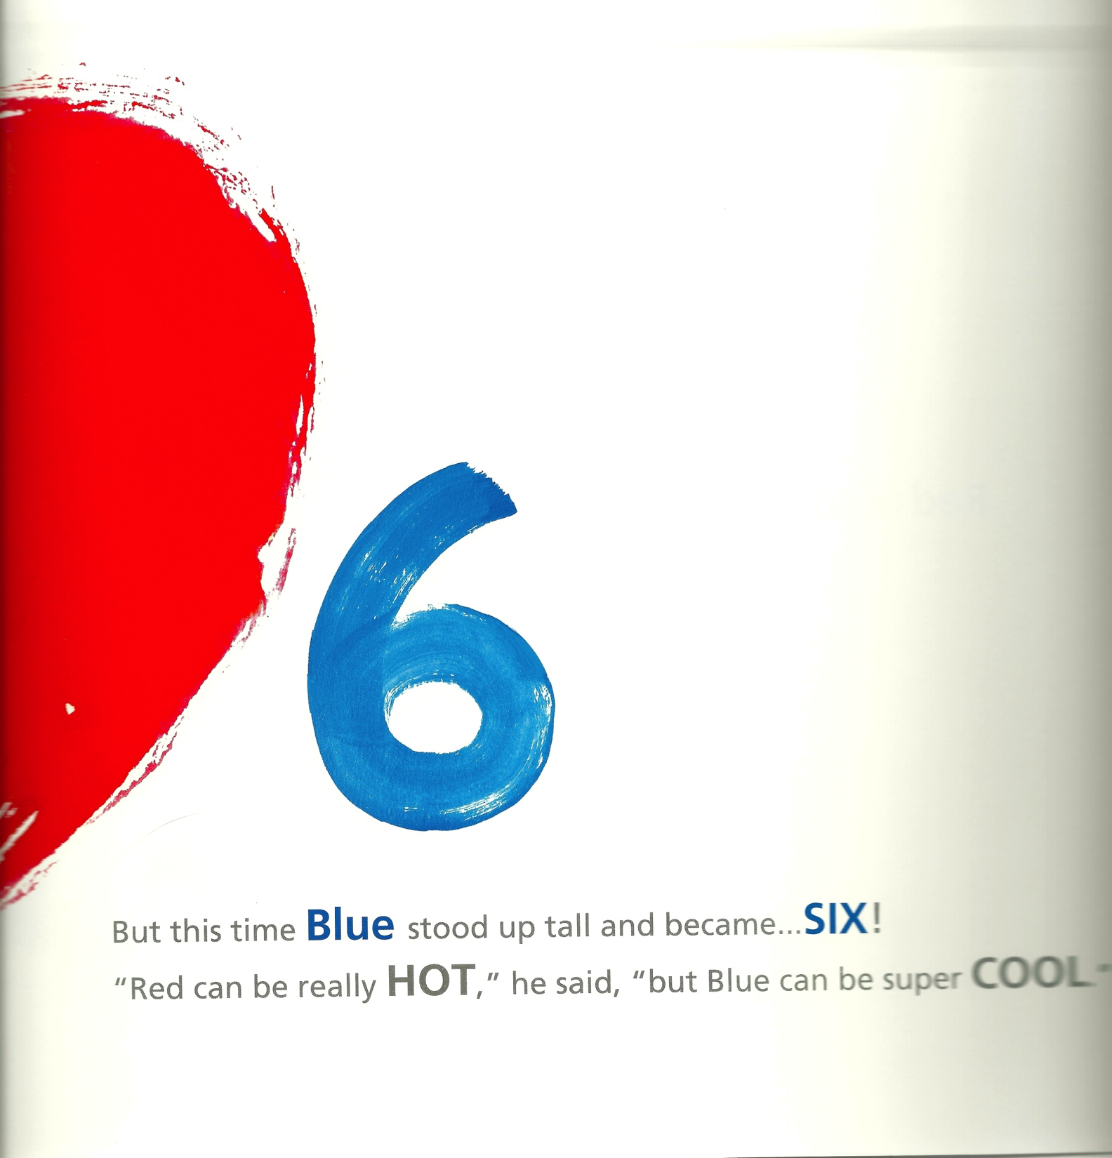

Slide 34
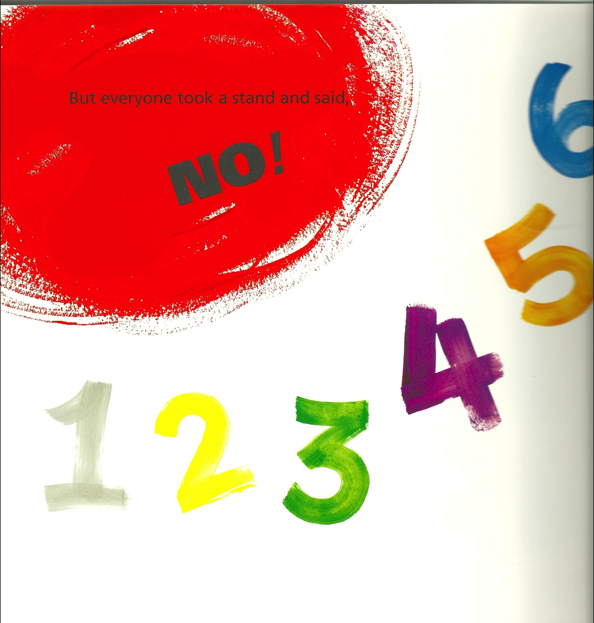

Slide 35
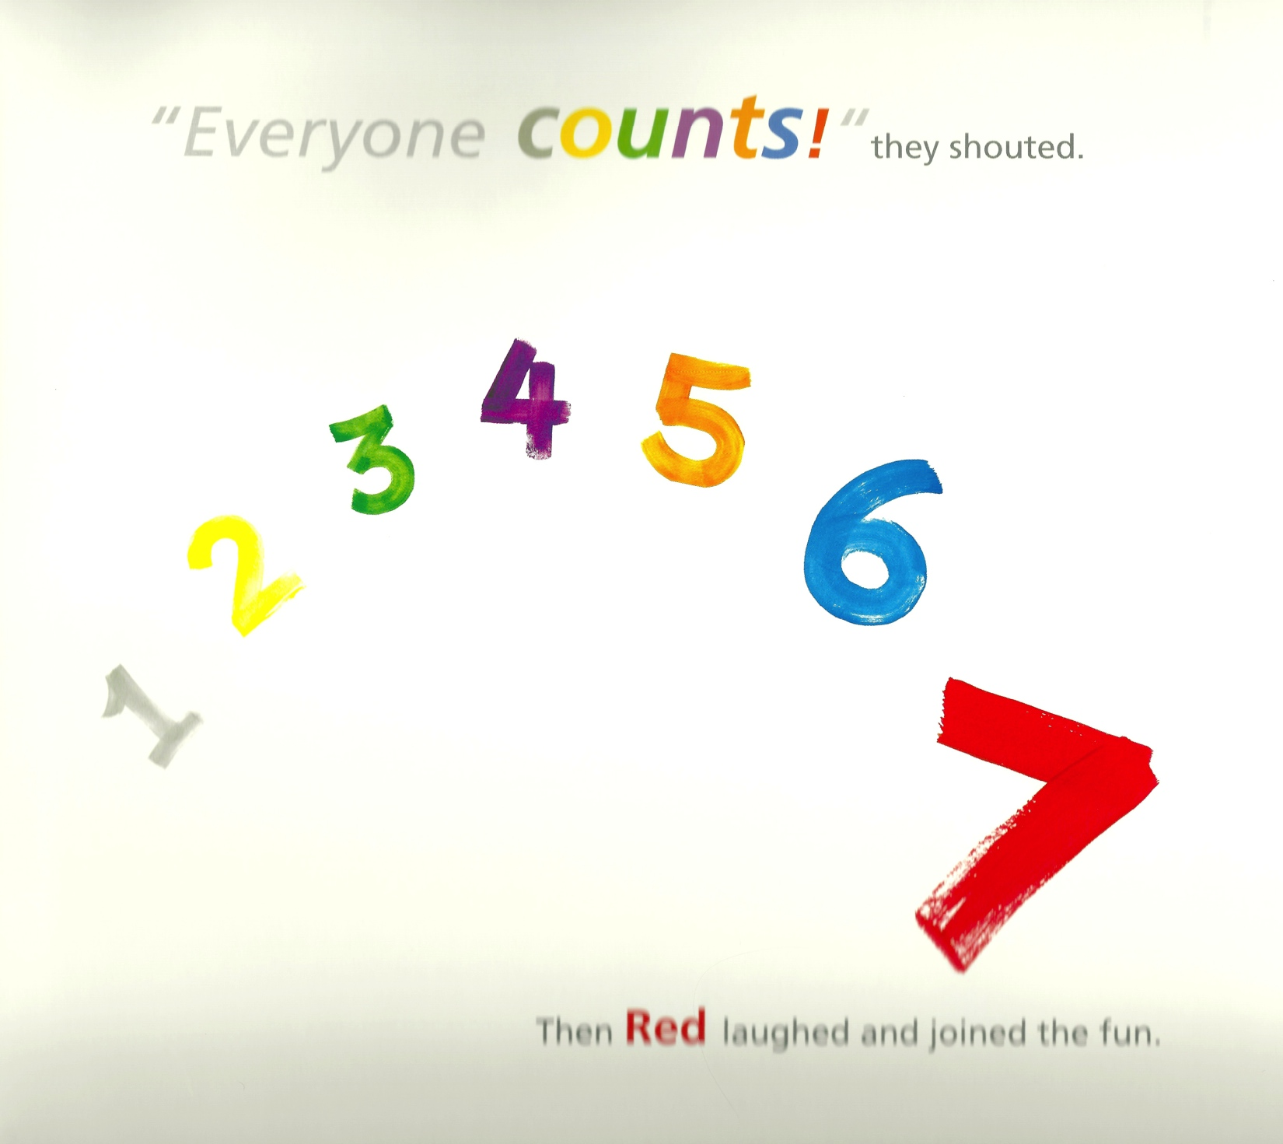

Slide 36
Puns?
Everyone counts!
Everyone felt a little blue.
bad
mean
bully
horass
intimidate

Slide 37
bad
mean
bully
harass
intimidate
tease

Slide 38
What is the Theme?

Slide 39
How do they deal with bullies?
The Tempest
One
Upstander
Bully
Bystander
Victim

Slide 41
English Language Arts Standards » College and Career Readiness Anchor Standards for Reading » 1
Read closely to determine what the text says explicitly and to make logical inferences from it; cite specific textual evidence when writing or speaking to support conclusions drawn from the text.

Slide 42
English Language Arts Standards » College and Career Readiness Anchor Standards for Reading » 4
Interpret words and phrases as they are used in a text, including determining technical, connotative, and figurative meanings, and analyze how specific word choices shape meaning or tone.

Slide 43
English Language Arts Standards » College and Career Readiness Anchor Standards for Reading » 9
Analyze how two or more texts address similar themes or topics in order to build knowledge or to compare the approaches the authors take.

Slide 44
English Language Arts Standards » College and Career Readiness Anchor Standards for Reading » 10
Read and comprehend complex literary and informational texts independently and proficiently.

